Slide 1

Historical analysis of stocks,
to evaluate growth, fluctuation, risk, and potential future performance.
Authors: Cesar Zea, Xingjia Wang,
Angelo,
Levan Getia
July 2023

Slide 2
Introduction and Methodology
Project Outline: We aim to analyse historical stock data to identify stocks with the highest percentage price changes,
lowest standard deviation, and a combination of both. We also predict future prices and compare
with real-time data
Methodology: We have used Python with Pandas, NumPy, Matplotlib, SciPy for data analysis, and linear regression
for future price prediction. We've also used a real-time stock data API for comparison.
Project Usage: Young investors are looking for information to choose stocks to invest on. The DYI investments trend
is growing. Based on this, evaluating different stocks to find the right ones to grow, considering the
risk aversion of investors is important.

Slide 3
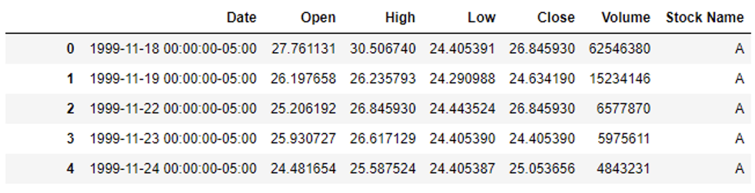
Data Collection and Preparation
Data Retrieval: All of the data used is provided by NASDAQ index. The database file was retrieved from kaggle.com
and stock files are presented in .csv format. Code, analyses all the files that are in .csv format in the
‘Stocks’ directory. Files are inclusive of Date, Price, Open, Close, Volume and Stock Name
Data cleaning: To ensure, robustness of our analysis, we have performed several data cleaning steps, such as
excursion of missing values, ensuring each column is of the proper data type, for example we
converted ”Date” column to datetime format for time series analysis. After these steps, we had
clean usable data ready for analysis

Slide 4
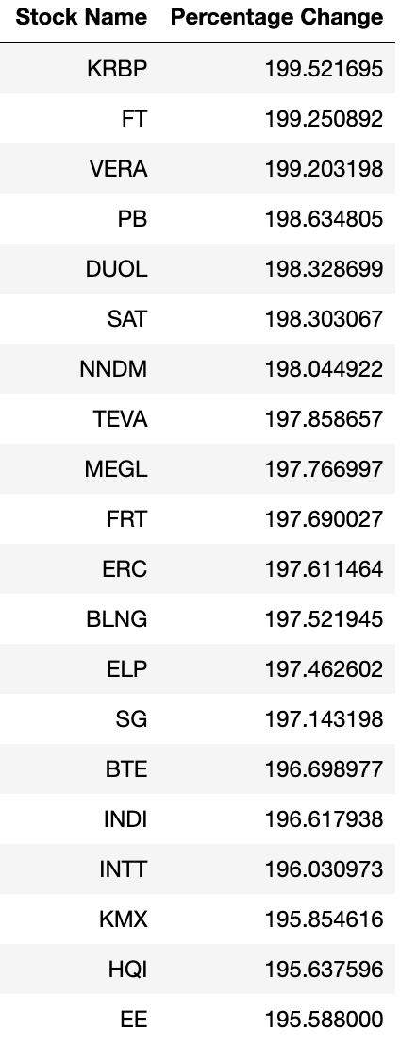
Analysis – Retrieving top 20 stock with highest price change
Stock selection for analysis: Since dataset offered by NASDAQ index is very
extensive and offers historical data from 20th century
onwards, to avoid any misconceptions or usage of
unchecked data, we decided to select last 8 years interval,
as our most relevant information for stock volatility
or price gain prediction.
Only top 20 stocks are included are showing price change of up to 200%
Table Description: Stocks are ranked in descending order from highets price change
to the lowest.

Slide 5
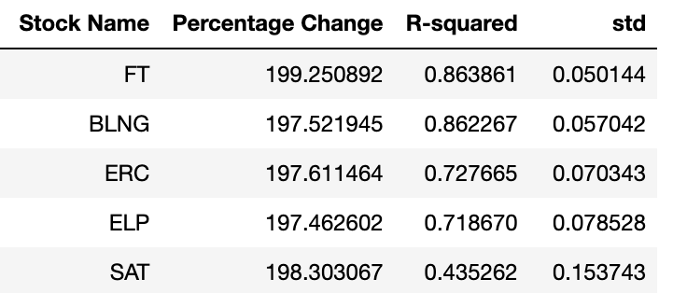
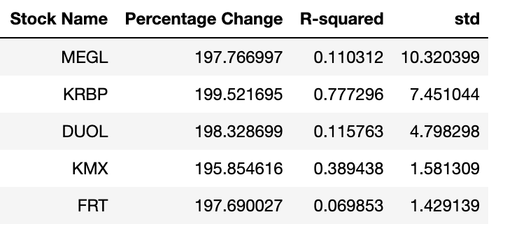
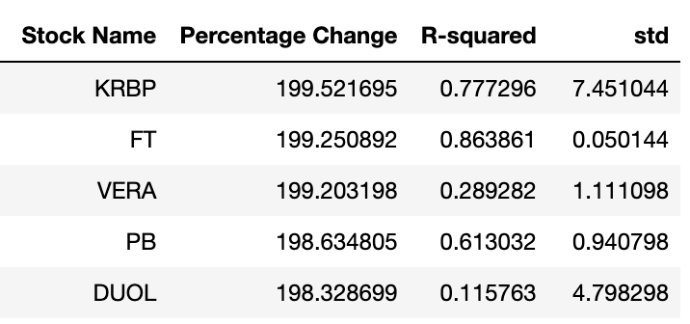
Analysis – top 5 stocks with categories
Top 5 stocks with highest gain and lowest variance
Top 5 stocks with highest gains, highets volatility
Top 5 stocks with highest gain

Slide 6
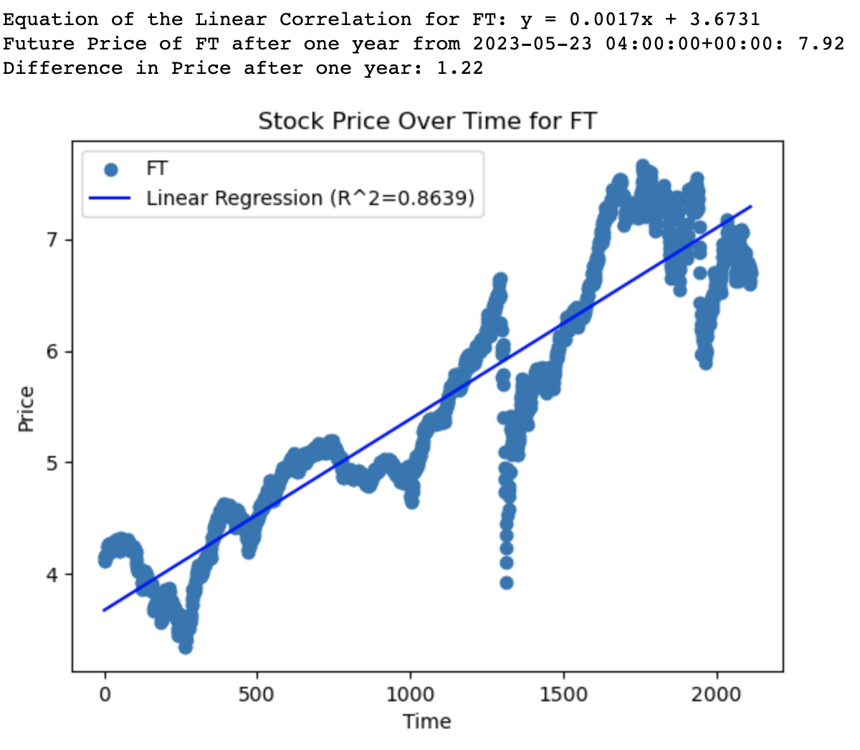
Analysis – visualizing stock price movements with scatter plots
Top stock performer in terms of lowest volatility and highest price gain
This graph indicates steady growth for FT stock, there is
certain variance, but nevertheless FT has highest gains
with lowest price variance combined. Our prediciton suggests,
Price increase of 1.22 USD.
Project/code provides such scatter plots and price differential
prediction for all the stocks that were included as top 20
stocks in terms of price gains

Slide 7
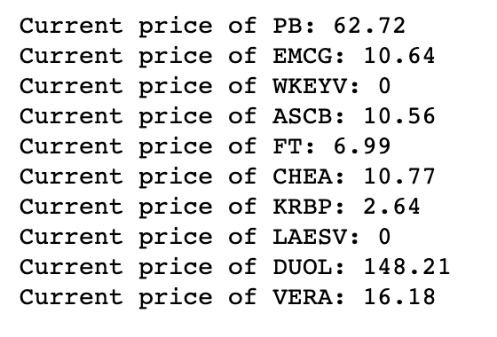
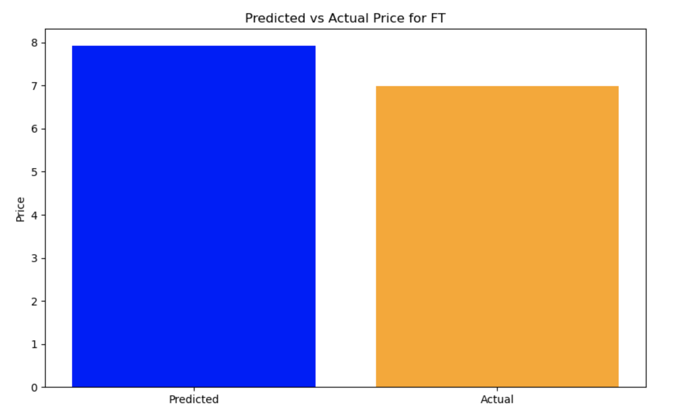
Real time comparison and future price predictions
Current price retrieval through Finnhub API
Code connects with Finnhub server and retreives current prices for the top stocks
Project/code than compares predicted price for the stocks to the actual
one and gives out a histogram visualisation of the difference

Slide 8
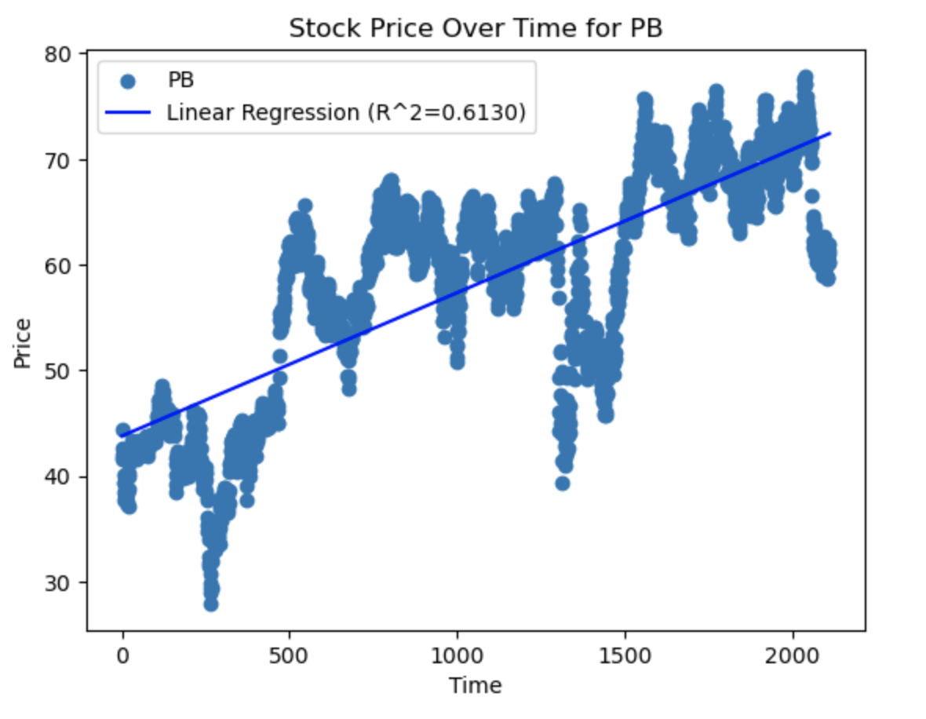
Summary of Findings
Volatility in stocks
According to our findings volatility does not necessarily determine success or failure of a stock as stock FT, was one of the
best performers, but nevertheless encountered very low volatility, whereas PB was could not perform as well, but experienced
significantly higher levels of volatility
According to analysis gathered through our project, we can say that
volatility can be defined as risk, given the factor that prices vary
to the huge extent. However, it is not tied to performance of a stock
rather than peace of mind of an investor.
Based on this information we can suggest the top 5 stocks based
Only on price:
KRBP, FT, VERA, PB, and DUOL.
The top stocks based on price stability (Standard deviation):
FT, BLNG, ERC, ELP and SAT
And the top based on price AND stability (R-squared):
FT, BLNG, SG, KRBP and TEVA

Slide 9
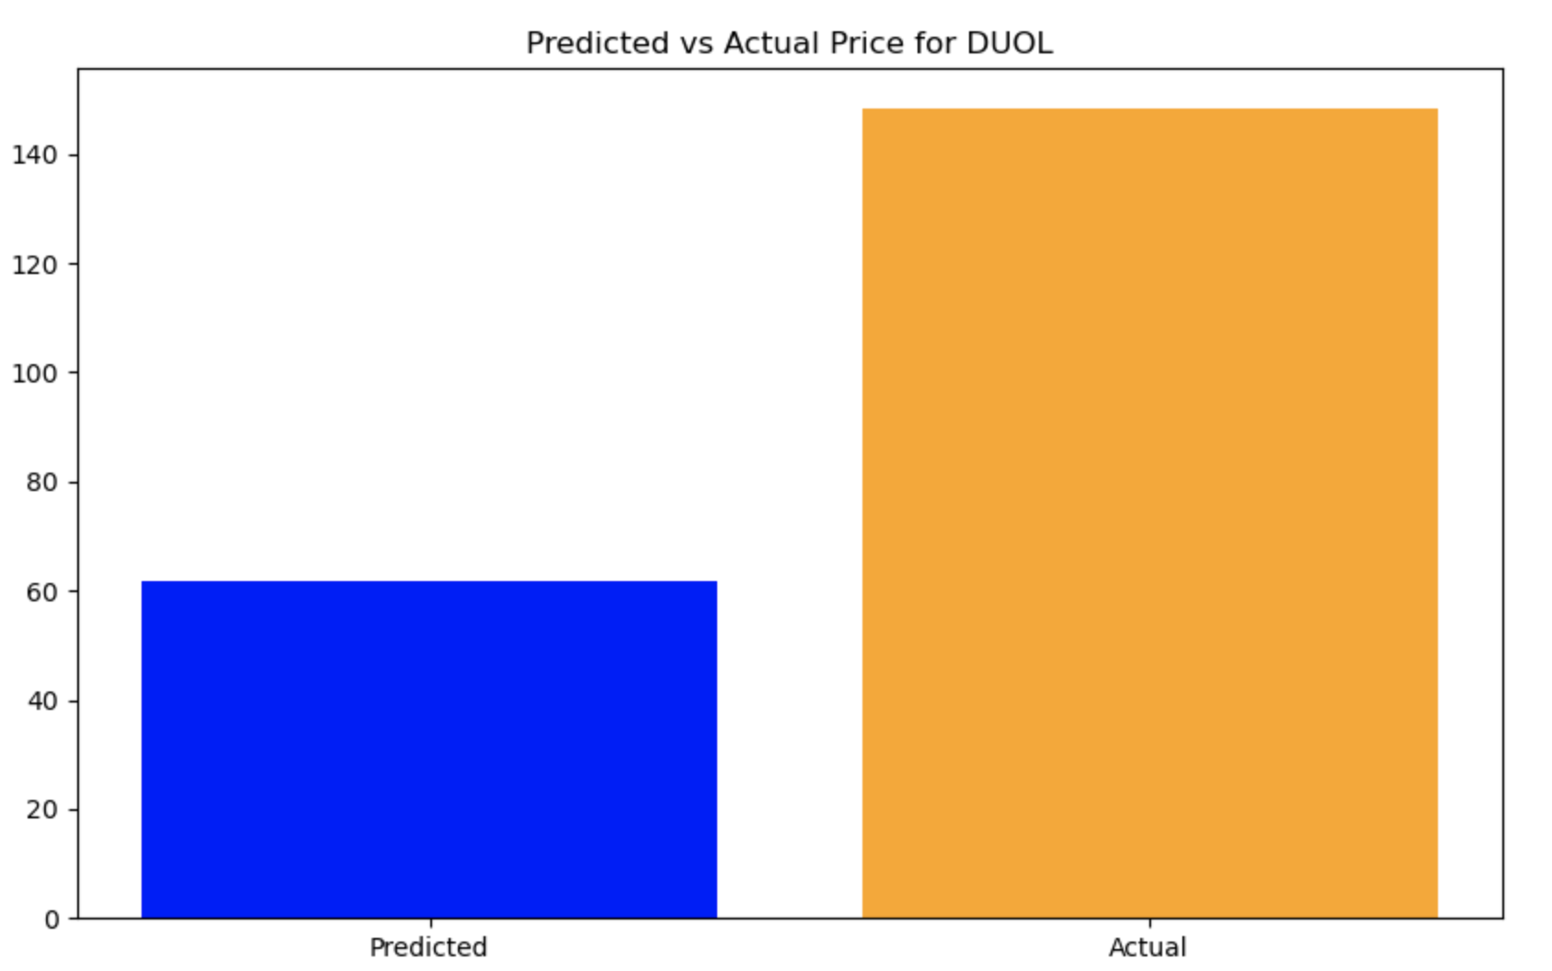
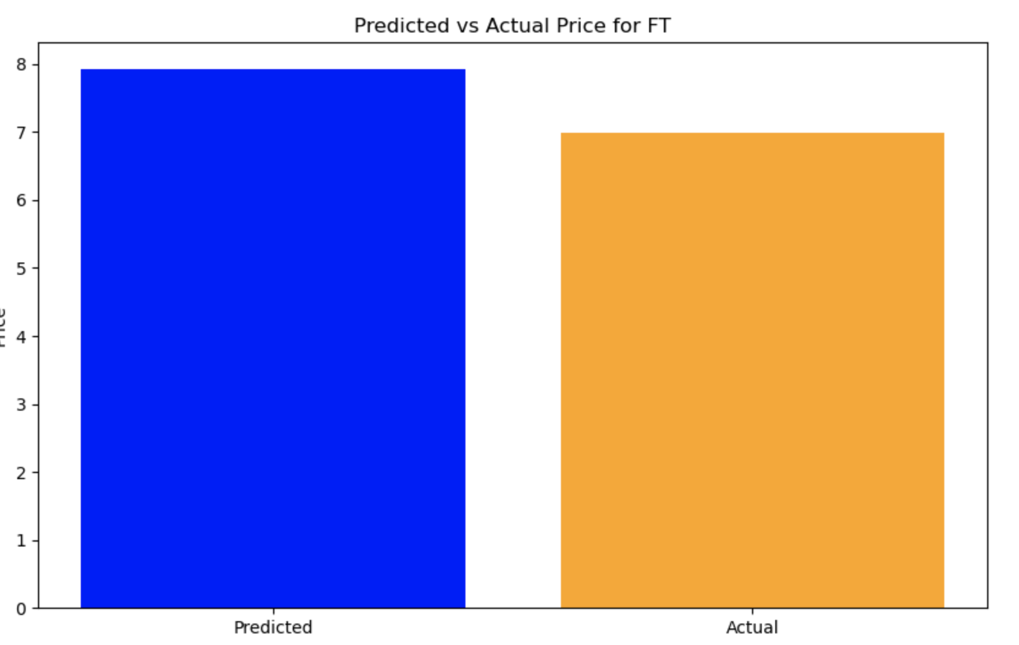
Limitations of the project
This project should only be used as a guideline for selecting stocks with less or more risk/volatility. That is if investor comes into
agreement with our view that more price volatility means more risk, than one can differentiate stocks on NASDAQ index, that
have had least price volatility over the past years, the highest price gain disregarding volatility and more.
However, our price prediction model, needs more comprehensive parameter inclusion and cannot be used as a legitimate
credential for making decision about your investment portfolio.
This graphs are to illustrate that predicted price is not consistent with the actual

Slide 10
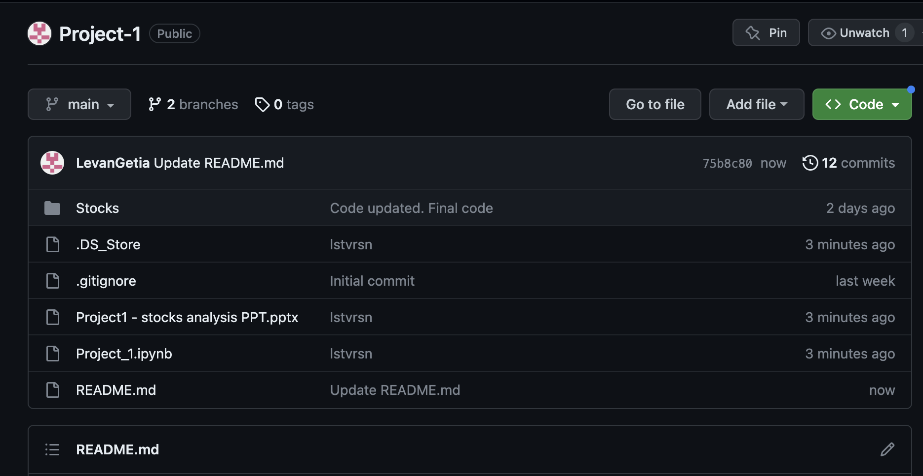
GitHub Repository and Readme
This is a screenshot of GitHub repository for the project.
Repository is public and easily accessible. Just clone it,
to your local machine and it will be ready to run. Project,
comes with its own set of historical data, however ’Stocks’
directory can be easily modified with other .csv format files
that will fit the needs of an user.
Repo explanation: Actual code file is in Jupyter Notebook file,
Called Project_1.ipynb.
Stocks is a directory containing .csv formatted data files
Project1 – stocks analysis PPT – is file for these slides.
Readme file – provides brief overview of what is done by this
Project/code
GitHub link: https://github.com/LevanGetia/Project-1

Slide 11
Final Slide
Cesar, Irene, Angelo and Levan
Thank you for you interest in this project and your time ☺

